Slide 1
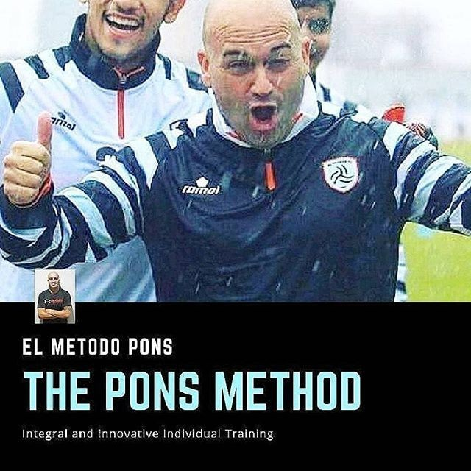
THE ”PONS METHOD”

Slide 2
INDICE :
1.0 THE PONS METHOD. INTRODUCTION.
2.0 REASONS TO DEVELOP THE PONS METHOD.
3.0 ADVANTAGES OF THE PONS METHOD.
4.0 MAIN IMPROVEMENTS WHEN USING THE PONS METHOD.
5.0 IMPROVING THE REHABILITATION OF THE FOOTBALL PLAYER.
6.0 COMPOSITION OF THE ASPECTS OF THE PONS METHOD.
7.0 CONCLUSIONS

Slide 3
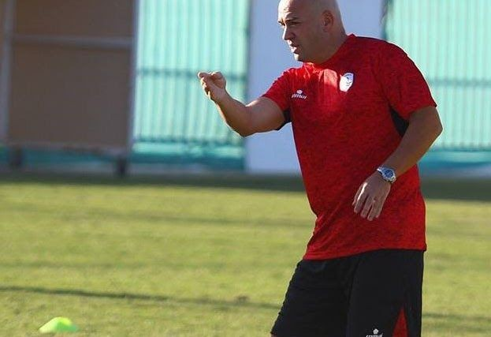
INTEGRAL FOOTBALL TRAINING METHOD
© David Pons Coach www.davidponscoach.net
1.0 THE PONS METHOD. INTRODUCTION.
I am David Pons Professional Soccer Coach, I was born in Barcelona but I have lived all my life in Mallorca (Spain), there I made my short career as a footballer, since at the age of 15 I had an accident that destroyed my kneecaps, and I recovered at 6 months I was playing in the national youth league, competing against FC Barcelona, but my knees began to suffer from those small fragments, having constant meniscus injuries, etc. on both legs, etc. So I decided to leave it years later I would start taking all my courses as a coach, I really enjoyed grassroots football in a club that gave me an important foundation and methodology to start my career well. CD San Francisco, where I won six championships and learned a lot since my first year, leading three different teams.
I learned to know how to differentiate how I should train, what I should communicate, prioritizing in each team would be different, but also, we already know that at the base the most important thing is to train, and I think that has always been my focus, to achieve results, being competitive, but at the same time giving the player an important individual improvement, loading training full of specificity, and from that experience at the base, perhaps all the other important inspiration will come out to end up carrying out this training method that even has surprised me.
After the first international experience I had to live it in Saudi Arabia, at Al Shabab FC, which I really enjoyed, I started to learn new things, I enjoyed respecting different cultures, different

Slide 4
personalities and knowing how to get the best out of each situation no matter how difficult it may seem. .
The next experience was in Qatar, in Al Ahli SC where I also enjoyed a wonderful city, and finally Thailand, a place that undoubtedly left a mark on me, so much that it was my last destination in the second division with the Nong Bua team. Pitchaya FC. in the Thai league 2 and is now about to be promoted to the first division. Enjoy the culture, the people, and achieve such tranquility that I managed to develop this method little by little, that within the simplicity it has, it seemed to me that as I developed it, it was taking on a great dimension and most importantly It is the one that will take, when it is done with the highest technology, in short it seemed to me that every time I gave it one more turn, each time it seemed that it had fewer limits, it was an open source for any coach in the world, regardless of the facilities , facilities, or characteristics of each club, federation or academy, which could be held anywhere in the world. I found that immensely gratifying as a quality contribution to modern football.
As I was developing the training method I was realizing the great improvement that it showed in different areas of training, but also, it was like football itself, as a whole, that is to say that after all those areas of improvement, they feed back each other, thanks to the method.
I think that over time because at the moment I do not think it is for all coaches, because I believe that the most trained, in tactical periodization, and those who are used to eliciting from their own games, from the rival's games, forms played to combat and counteract opponents, and thus create content-rich training to achieve performance and results are the ones that will be most appreciated, having a method like this, in addition to implementing it, as part of their weekly improvement, through the ways that each coach deems appropriate, individual,
semi-collective, collective form, football teams will achieve more the performance of the entire set of the entire club, it is clear that the more professional the method is treated, the more
components of improvement, analysis and control it has, but it is for all categories, who wants to go a step further, and what is more, I am convinced that it will also do so in other sports. This is due to the fact that it is open source, that is, every coach can perform his exercises depending on his analytical skills, his methodology, but especially depending on his game model.
My vision says that in the not too distant future, the smartest companies with the most advanced technology will contact to understand that this method is the future of training, not only in football but also in many other sports.
After much discerning, I understood that current football needed analytical training that was treated as a whole and that would give a broader meaning to tactical periodization. This is how the Pons Method was created, on an island in eastern Thailand. The tranquility gave rise to creativity, to be able to get into my deepest thoughts about my idea of football and elicit this feeling for this extraordinary sport, which has helped me grow.

Slide 5
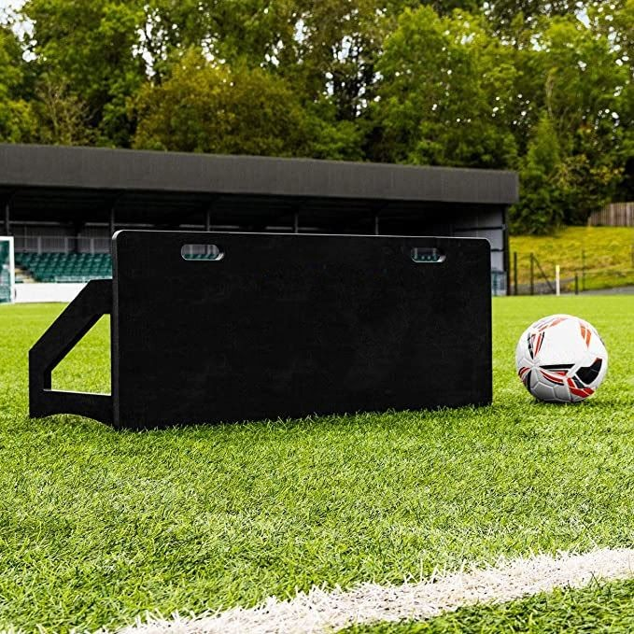
2.0 RAZONES PARA DESARROLLAR EL MÉTODO PONS. ( EFICIENCIA Y PRODUCTIVIDAD)
The analytical method had been partially superseded by tactical periodization. With this method, the analytical method regains relevance as it is fully contextualized, thus contributing to the improvement of many plots of the sports area.
The Pons Method in itself is already a compelling reason to seek an advance in the training methodology. Because its essence is to work each training as a whole. And extracting much of its essence from the same game and focusing on the opponent's game. Thus creating a battery of work and training, (Database) that will have more and more impact with training. Working all areas of training at the same time. And that for the analytical method, is an important change of direction.
Working in training with panels, which replace players, who are doing somewhat superfluous work, outside of the specificity that is required by the coach, can be worked more with small groups, but seeking more individual improvement of each player . Improving individual and semi-collective training and providing greater productivity to collective training, with the entire team.

Slide 6
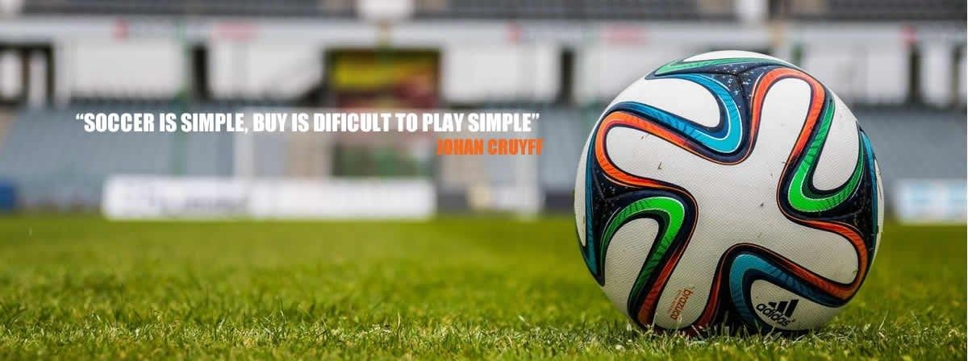
2.4 There is no bad method, I certainly do have to choose the coerver method for the base, and for some sequences of professional football. And I prefer tactical periodization and the Pons Method, as a perfect combination for me to develop a team in all facets of training. But here each coach is different
3.0 ADVANTAGES OF THE PONS METHOD.
3.1. Under this method, players progress in all areas of training,
3.2 It is a method that can go hand in hand with tactical periodization.
3.3. With this method it is possible to optimize the weekly training time in a more productive way.
Relying on individual and semi-collective training in addition to giving more productivity to the group, we improve training exponentially since the efficiency is increased to define, through these exercises, the game model.
It is possible to give importance to the emotional component in relation to technique and above all to individual tactics. Two concepts that, by wanting to treat them in global training, cause losses of continuity in training.

Slide 7
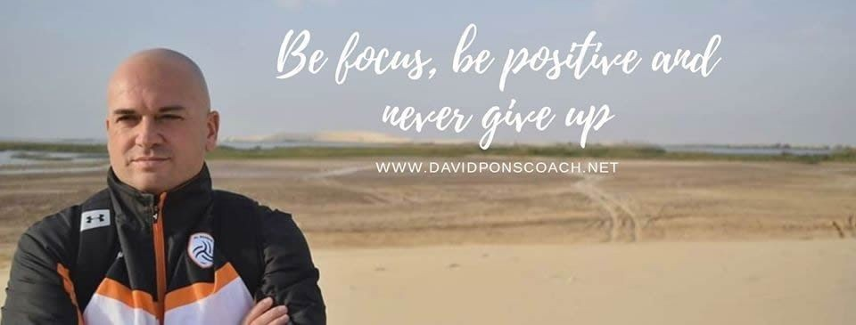
4.0 MAIN IMPROVEMENTS WHEN USING THE PONS METHOD
An individual improvement of the soccer player is achieved in an integral way. The principle of individuality is essential for the improvement of the footballer in general and the whole.
It makes collective training effective and productive.
Substantial improvement of collective and individual tactics in a comprehensive manner.
You can introduce technological aspects that help to implement the method.
Improve the team's game patterns by extracting from the game model combined plays or creative play forms, in which the coach believes that he can improve the player individually, by groups, by lines or collectively.
Optimize the soccer player's rehabilitation work and get his return to the team in a more confident, more prepared way.

Slide 8
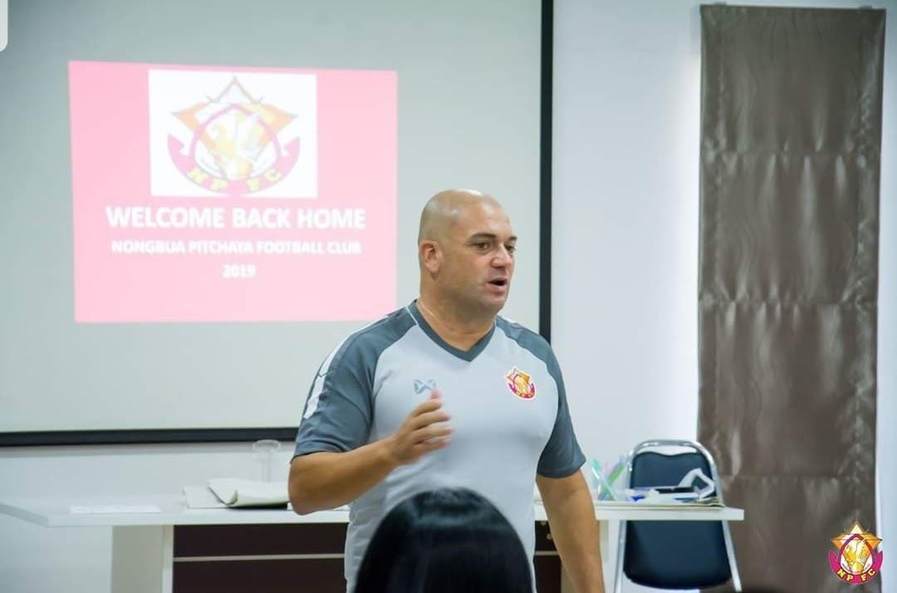
4.0 PRINCIPALES MEJORAS AL UTILIZAR EL MÉTODO PONS
Knowing the urgency to obtain good results in a short space of time in professional football, the Pons Method provides knowledge of the model at the beginning of the season or if there are subsequent incorporations of players.
Improvement of training for non-summoned players, being able to perform more real, more competitive exercises, thus ensuring that the player understands that they should not lower their arms and that they must continue to improve to get more minutes, performing totally specific training for their position or positions in the countryside. The principle of individuality is key in this Pons Method.
Facilitates the work of the scouting department. An exhaustive analysis of the opponent's game can be carried out to know with what forms played and tactical components we must carry out, individually and collectively, to counter and fight the opposing team, by positions, lines or collective game, conceptualizing the exercises to be carried out each week more quickly and effectively, while improving the individual and collective tactics of our players.

Slide 9
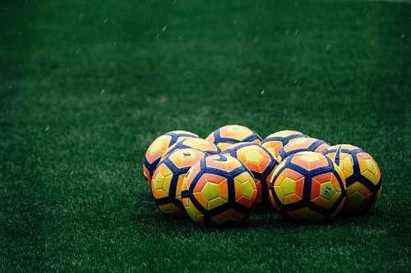
5.0 IMPROVING THE REHABILITATION OF THE FOOTBALL PLAYER
One of the fundamentals of this Pons Method is the key to improving the injured player. This Pons Method is the necessary intermediate step between the analytical system used by the physical trainer and the rehabilitator and the introduction of the player in group training with partners.
This necessary intermediate step gives the player greater confidence, self-esteem and security towards his injury and his introduction into the group, since what he does is 100% real, but without opposition. And it also improves the coach's confidence in the player's return in top condition after a complicated injury.
In the world of football, there had always been a lack of a methodology that provides confidence to the player before beginning his integration into the group. In this way, he feels safer to recover, because the entry with the ball is already with high intensity. This method helps to smooth this process, controlling the footballer's recovery step by step.
The PostMethod® believes that the game is to be treated as a whole and helps to improve, among many other things, a series of simple and compound movements and actions that involve all positions in different parts of the field.
This method needs the synergies of different departments to properly control all the little details: coaches, physical trainer, scouting, medical department, etc …

Slide 10
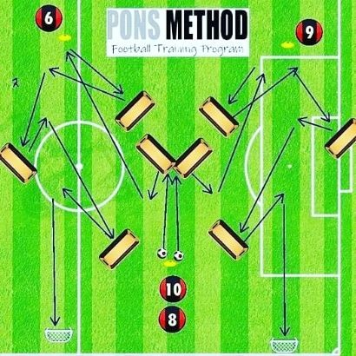
6.0 COMPOSITION OF THE ASPECTS OF THE PONS METHOD.
6.1. Individual training:
The Individual Training Method in this Pons Method, for me it was necessary after my experience around the world to improve several areas in this type of individual training so that it would be more didactic, more specific, more real to the competition, more fun, with more control over the small details, in the variants, and that it was efficient in all areas of training, that is, it is an all in one.
It is controlled by the physical trainer with the relevant software and tools to control the intensity of the exercise, depending on the player's fitness, tactics, having a specific work group to undertake this type of training, or being the own coach who performs the exercises, his second coach understands small tactical details to correct to provide tactical rigor, to the exercises, knowing how to rectify the control aspects, also controlling the technical and tactical aspects since when training at first without opposition, You can control the speed of the actions, the profiling, the control, the speed of the pass, distances, timing, etc. and also work on the emotional aspect of the player, it is clear that by working without opposition and being as real to the competition as possible, the player takes it as a challenge, so his self-confidence grows, his motivation and also has fun , because it is real football, and you know that you are learning a range of instructions from expert coaches in small details, in addition to other factors

Slide 11
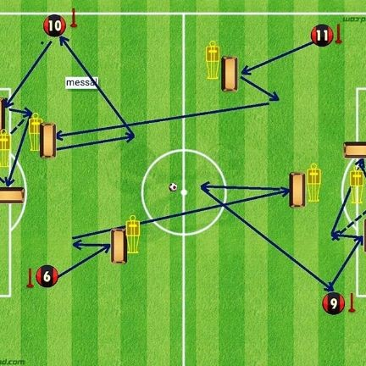
6.2. Semi-collective training. By lines, groups or positions.
The semi-collective training method in this Pons Method, This training mode can be done in an extra way as an individual training, with the group of non-summoned players, looking at their positions in order to achieve a balance in the exercises, and that each one works in a specific way for their position and their daily improvement so that each time they have more minutes.
It can also be used within training, since the collective method be more effective with this method by having more productivity when using panels, in the less important positions in an exercise, many players will be rewarded by working on another side in a specific way, and real to their positions in the field, through this semi-collective method.
This exercise of the image that requires at least 12 players with the pons method, with four to six players can be carried out.
6.3. Collective training.

Slide 12
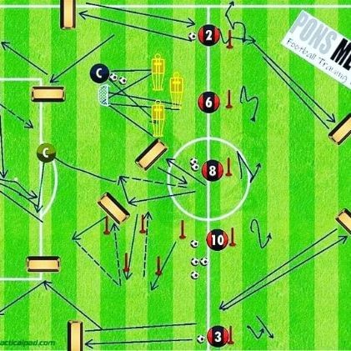
The Collective Training Method in this Pons Method, collective training is improved with this method, improving specificity and productivity, since, as seen in the photo, the player who performs a minor role in the circuit, or any exercise that is carried out, is replaced by a panel, that allows, to have an efficiency in the training, since the players carry out more specific training for their real match positions, and promoting different improvement exercises that are more important to achieve a better evolution in the development of the footballer throughout the season.

Slide 13
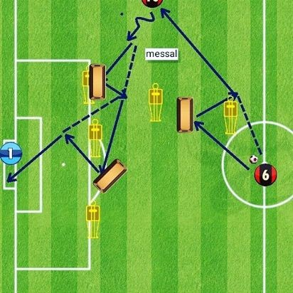
6.4. Rehabilitation training.
The training method improving the soccer player's rehabilitation area in this Pons Method, I had always lacked an intermediate method for the soccer player to feel more confident after an injury, to enter into the group dynamics. In the image we can observe in the corner a play of the number 10 making inwards. doing a couple of combinations in wall shapes, to get into the area, but it does not need four players, with the presence of the physical trainer or rehabilitation, and the player is enough to carry out a complete recovery exercise, previously exercises would be performed softer according to their position on the field, and at the time of the player's recovery, the physical trainer would also measure his physical condition with the tools that he deems appropriate, and the recording department would record the session to rectify small details, post training . All exercises of course based on the head coach's game model.

Slide 14
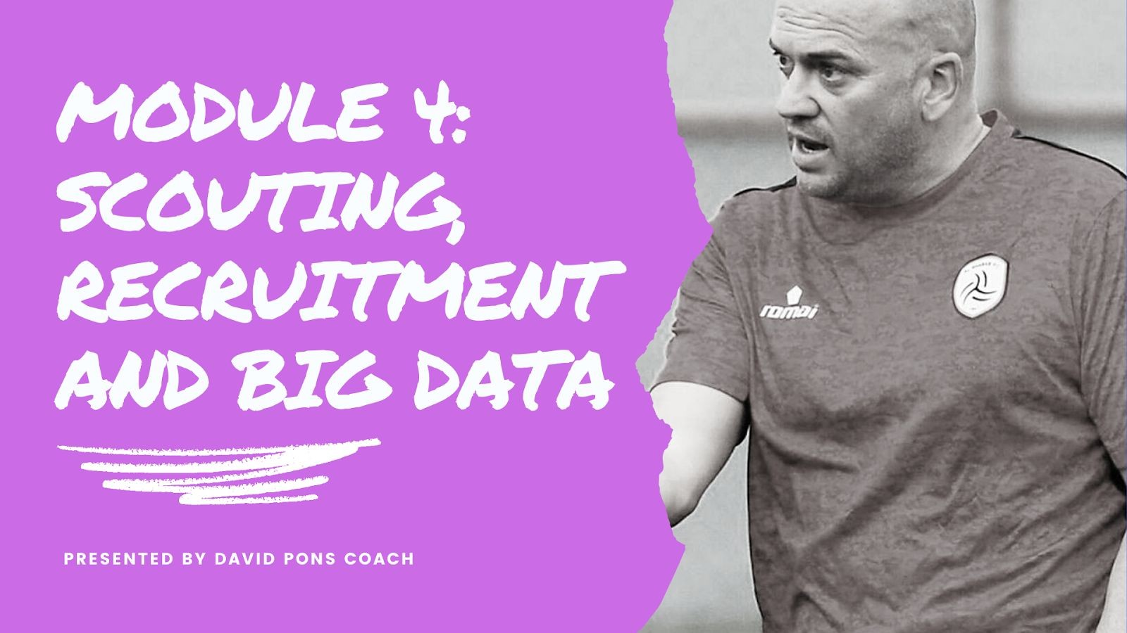
6.5. Training based on scouting on opponents.
The Training Method based on the contribution of the scouting department in this Pons Method, When we enter this method, we begin to create a database, which allows the coach after the scouting department has made its analysis on the opposing team, allows you to combat deficiencies that the opposing team may have. We have more and more weapons to fight rival teams, because not only do we work on the specific things that we want to work on to combat our adversaries, but we also invest our weekly time to convince the player of it, through training with the pons method, through For me it was necessary after my experience around the world to improve several areas in this type of individual training so that it would be more didactic, more specific, more real to the competition, more fun, with more control over the small details, in the variants, and that it was efficient in all areas of training, that is, it is an all in one.
It is controlled by the physical trainer with the relevant software and tools to control the intensity of the exercise, depending on the player's fitness, tactics, having a specific work group to undertake this type of training, or being the own coach who performs the exercises, his second coach understands small tactical details to correct to provide tactical rigor, to the exercises, knowing how to rectify the control aspects, also controlling the technical and tactical aspects since when training at first without opposition, You can control the speed of the actions, the profiling, the control, the speed of the pass, distances, timing, etc. and also work on the emotional aspect of the player, it is clear that by working without opposition and being as real to the competition as possible, the player takes it as a challenge, so his self-confidence grows, his motivation and also has fun , because it is real football, and you know that you are learning a range of instructions from expert coaches in small details, in addition to other factors

Slide 15
7.0 CONCLUSIONS:
The intention of this method is not that the movements come out exactly mechanically, but rather to provide the players both individually and collectively in work groups, with an essential tool for the continuous improvement of the footballer, and the collective, as improvement constantly and totally focused on how to beat our rivals, through an exquisite tactical rigor that allows them to assimilate any tactical concept that the coach wants to appear in their matches, and to be able to develop it with the best possible tactical, technical, physical, and psychological option and always looking for productivity in training. Trained fewer players, but more specifically, we understand that, that sometimes, less is more.
By controlling these parameters of our game model, we can choose the principles and sub-principles to develop when the coach can create the relevant exercises on his game model, in this way we will eventually achieve a database to fight the team rival using the Pons Method.
I encourage technology companies to contact directly to provide this method with advanced technology, since it will not stay in Football, this is applicable to many sports. So much improvement must be appreciated and valued.
I also understand that this method that at the time that we are many players finish their career and the next day are TOP coaches, this method unmasks mediocre coaches, since if it is done without tactical knowledge acquired in years of going through many categories and Going into the learning of multiple methods and models of play, one of two, or it will be seen that the plays played, forms played, analytical exercises, do not make sense, with your idea or model of the game or rectifications are not adequate. Or hire someone truly professional to carry out this type of training so that through the relevant dialogue with the coach, they are carried out according to the game model of the first coach and the tasks can be distributed as they decide.
I hope that this method is an important contribution for many people in the world of football, not in the short term maybe because as I say it is for coaches with significant experience, who understand football as I understand it. Like an everything. And I also understand that history tells us that the Coerver method took two decades to become known as it should in a global way, as well as the tactical periodization that many do not quite understand.
I only pretend that whoever wants to take advantage of it, can do it and find in this method an open source to enter and dive into it as a method that facilitates performance in a team of
For my part and in the midst of this Covid19 pandemic, which is when I have had the time, the ability and creativity to create the method, I am proud to be able to share with the people who have my vision, with this method so that they can use it for non-profit purposes. And the technology companies

Slide 16
that see as I do, the possibility that the method has to do it globally with appropriate software to facilitate the work of the trainer, to give this method an increasingly advanced methodology, and as I say not only in I see football for many sports, so please contact me to advance the synergies to develop the innovative and future project that surely is an extraordinary contribution to football.
The Pons Method: Breathe Soccer.
This Method while nobody profits from it, is a contribution to football, its coaches, clubs, performance academies and federations that want to bet on it to reach performance in a faster, more effective and productive way.
For any question, clarification, comment, feedback, thank you, that you want to make or for any job offer, in professional teams.
I leave my contact information.
David Pons coach
©David Pons Coach
Mobile : +34 658 33 09 60
davidponscoach@gmail.com
www.davidponscoach.net

